Slide 1



Slide 2


Slide 3



Who we are
Vision
Regional and international leardership in the field of HRM
Mission
Enhance the work environment and managing employees, Who are the most important assets of your organization with effeciency and effectiveness

Slide 4


Slide 5


Slide 6


Slide 7

Our Team
Naira Lotfy
Mohammed Abdelrahman
HR Manager
Ahmed Samir
Hossam Mostafa
Ahmed Sameh
Marketing Manager
HR Consaltants

Slide 8

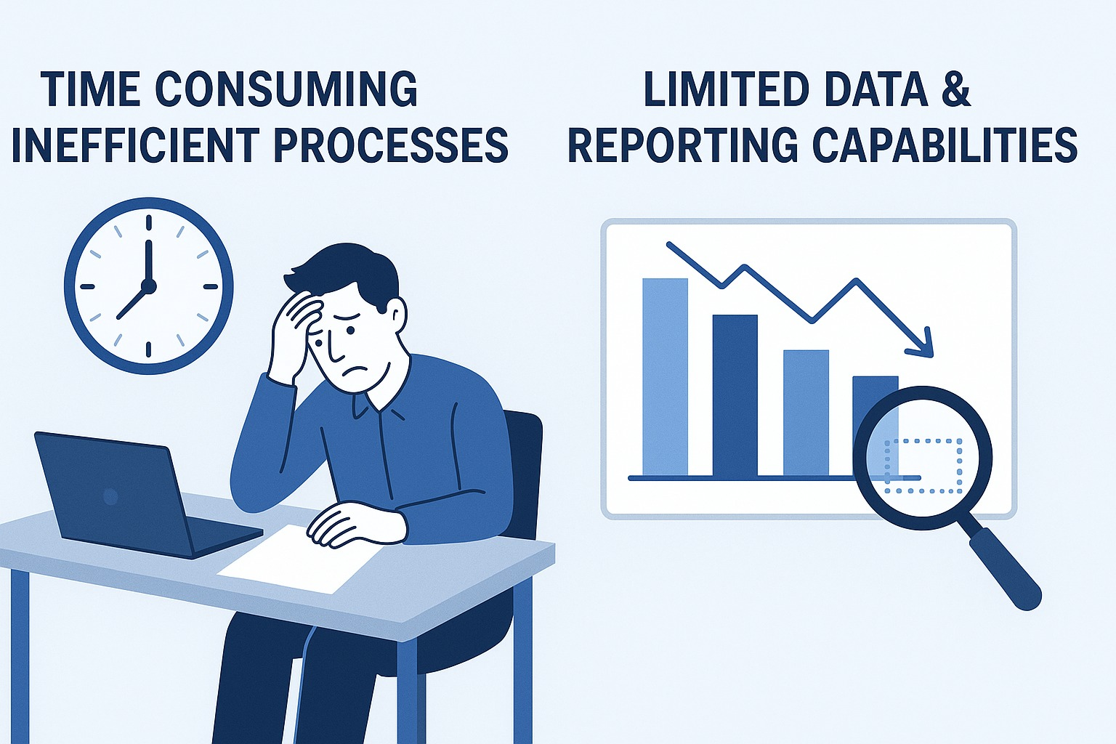
Problems of traditional HRM Processes

Slide 9


Slide 10
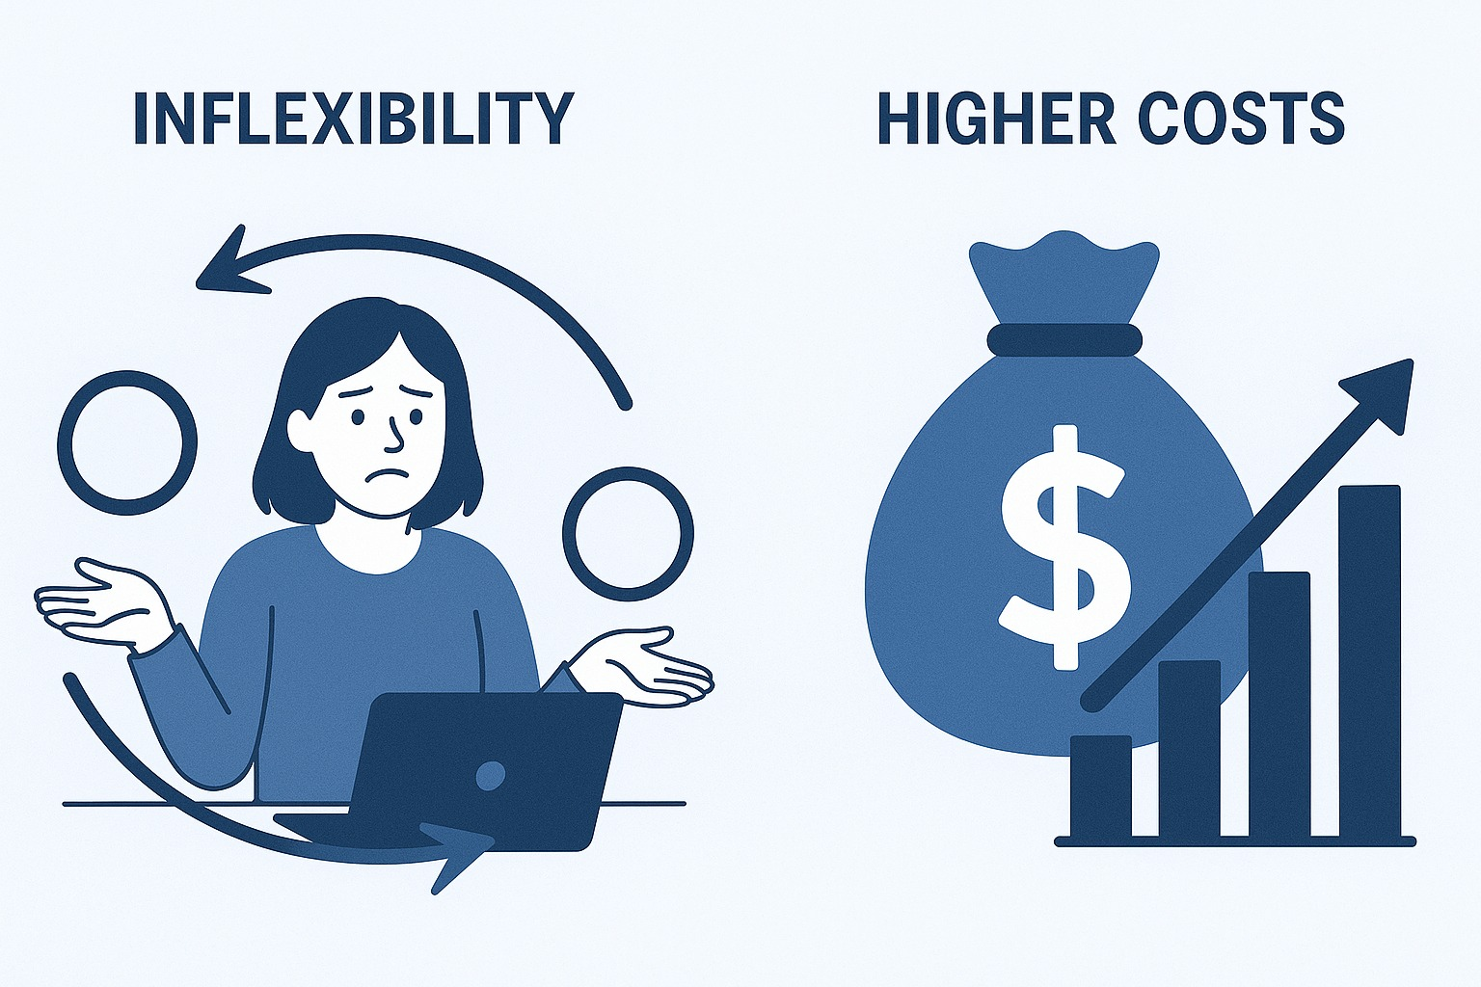

Slide 11

Key features of Oracle ERP System
Security and Data protection
User-friendly interface
Employee self-service
Allowing users to register and navigate with ease
only authorized users can interact with sensitive information.
Access and manage their own information
Customization options
Payroll Management
Compliance with Labor Laws
To match your needs and your organization policy
Automated Payroll calculations
Regulatory updates

Slide 12


Slide 13
Managing and developing the Personnel department
Collection of all necessary recruitment requirements, Dealing with social insurance & Labor office
Providing the technical support to use the application effectively
Creation and management of employment contracts of all kinds
Oracle staff training
Providing accurate reports to support decision-making
Setup an HR system for your organization on Oracle

Slide 14
Our Services
Managing and developing the Personnel department
Collection of all necessary recruitment requirements, Dealing with social insurance & Labor office
Providing the technical support to use the application effectively
Creation and management of employment contracts of all kinds
Oracle staff training
Setup an HR system for your organization on Oracle
Providing accurate reports to support decision-making

Slide 15

Examples of our work

Slide 16
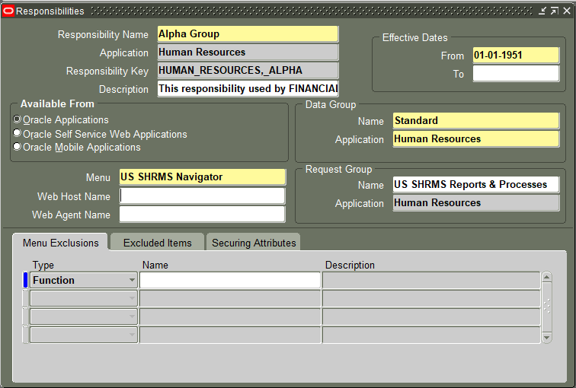

Slide 17
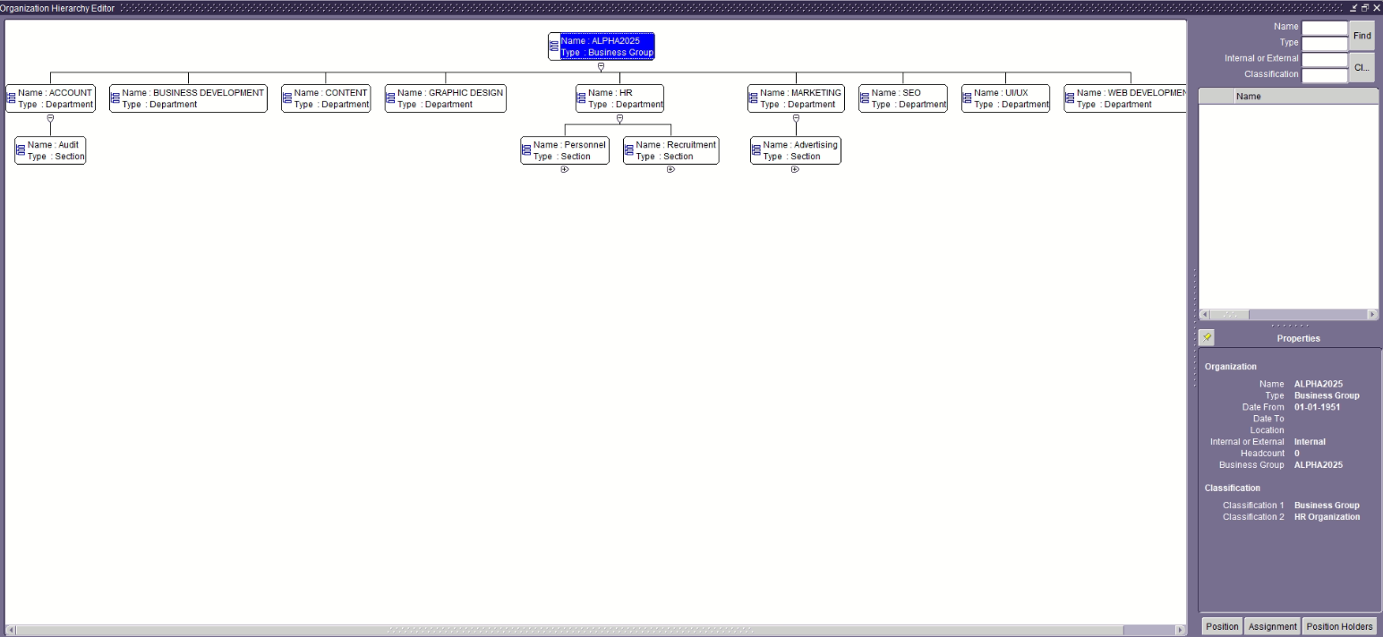

Slide 18
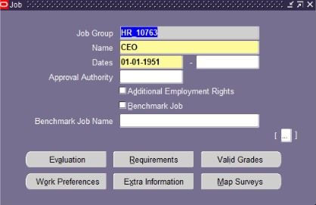

Slide 19
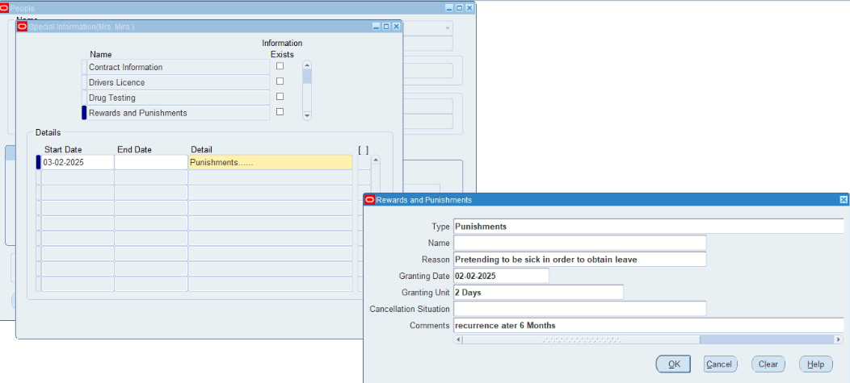

Slide 20
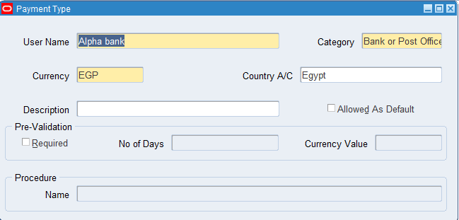

Slide 21
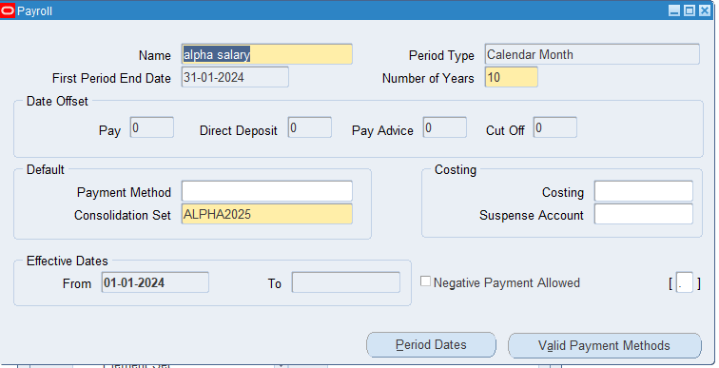

Slide 22
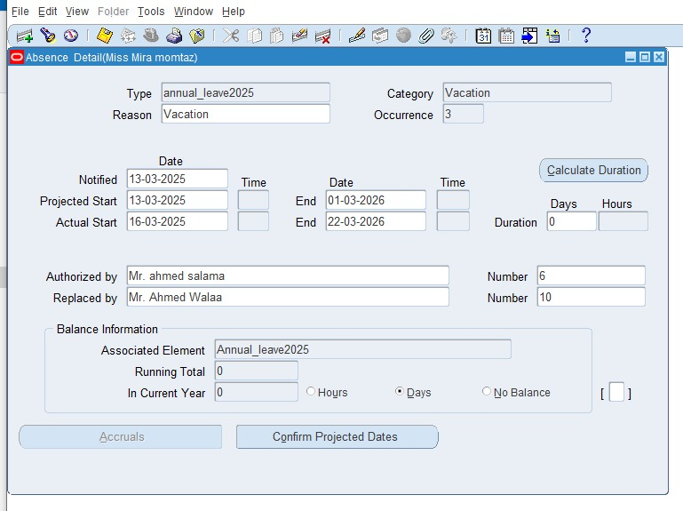

Slide 23
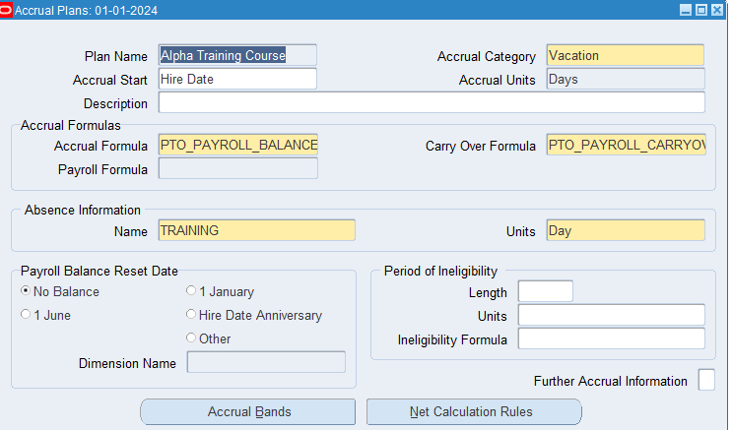

Slide 24
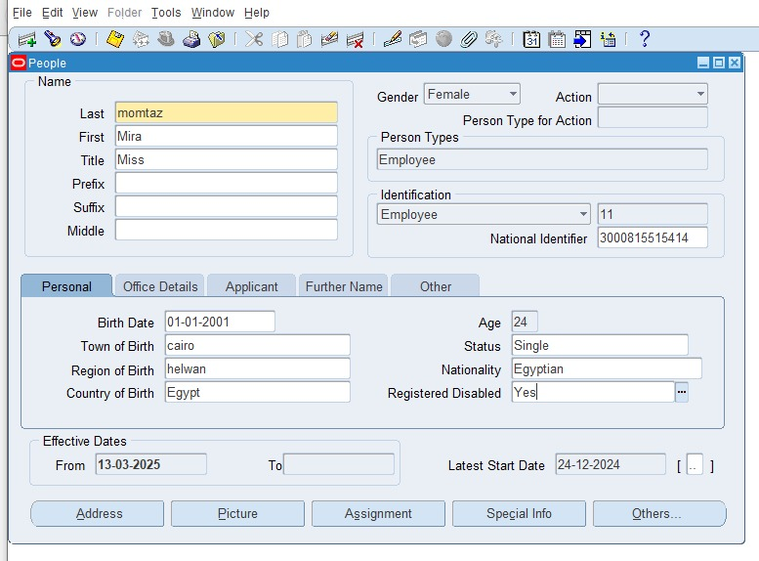

Slide 25
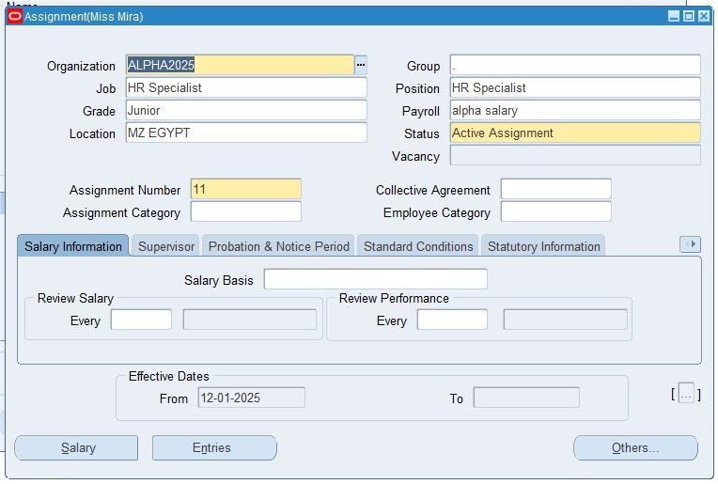

Slide 26



Thank you
Contact with us
https://www.linkedin.com/in/alpha-group-67890
https://www.facebook.com/AlphaGroup.Official
https://www.alphagroup@gmail.com

Slide 27


